Slide 1
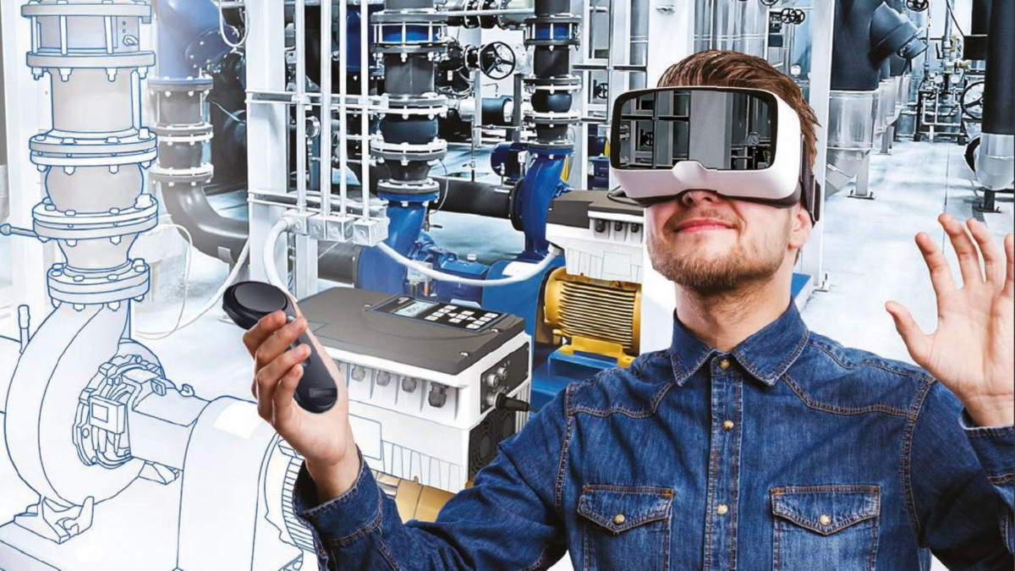
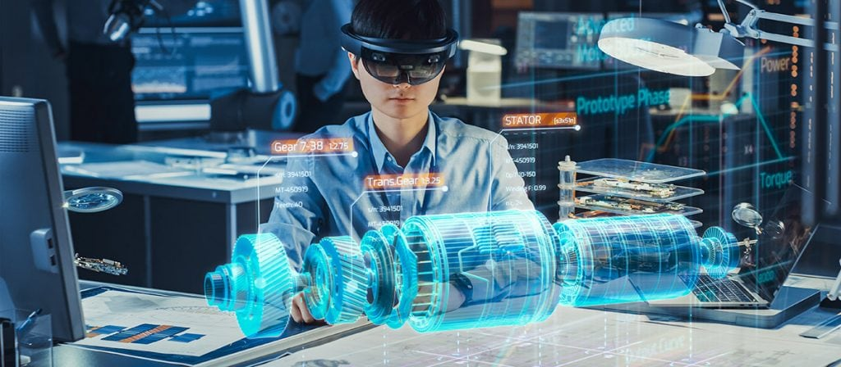
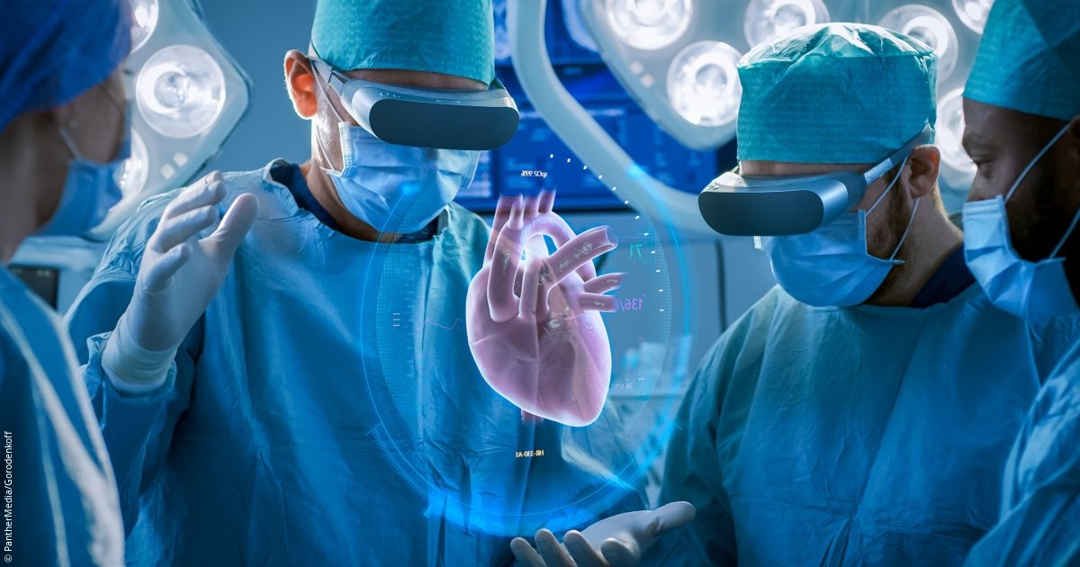
CareerQuest Virtual Reality
Business Model Innovation in an exponential world
Eindhoven University of Technology
Mechatronic System Design Trainee
Elham Honarvar
March 2023

Slide 2

Goal
The idea is to create a VR environment that simulates a workplace or classroom setting, where students can learn, and practice skills related to different careers. For example, they could practice coding in a virtual tech lab, or perform simulations of medical procedures in a virtual hospital or even a virtual court for those who are interested to become lawyer. Moreover, students can interact with different virtual characters who are trained based on the information provided by professionals in each field.

Slide 3
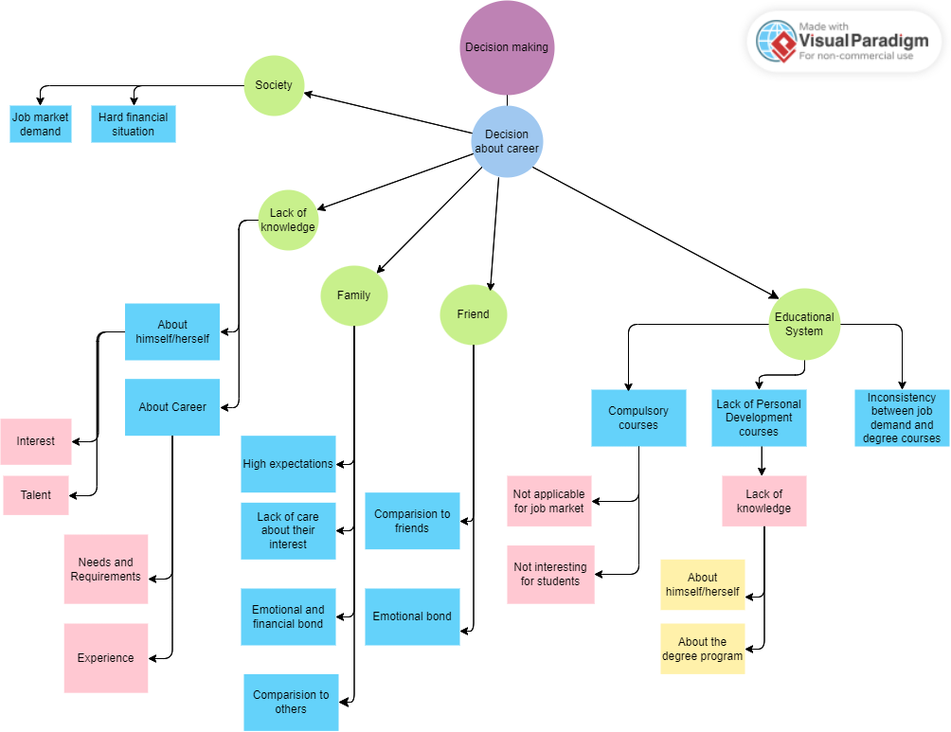
Item Tree

Slide 4
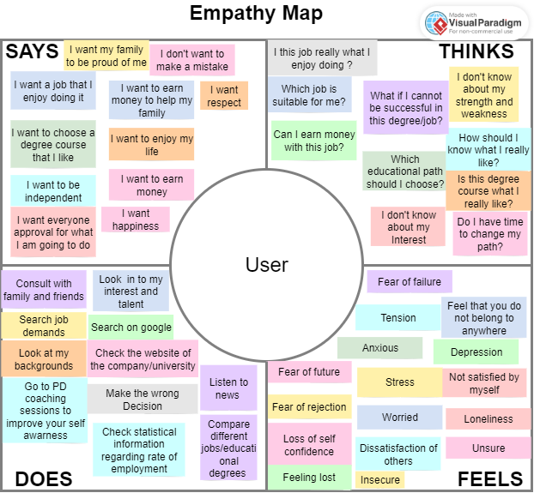
User Empathy Map

Slide 5
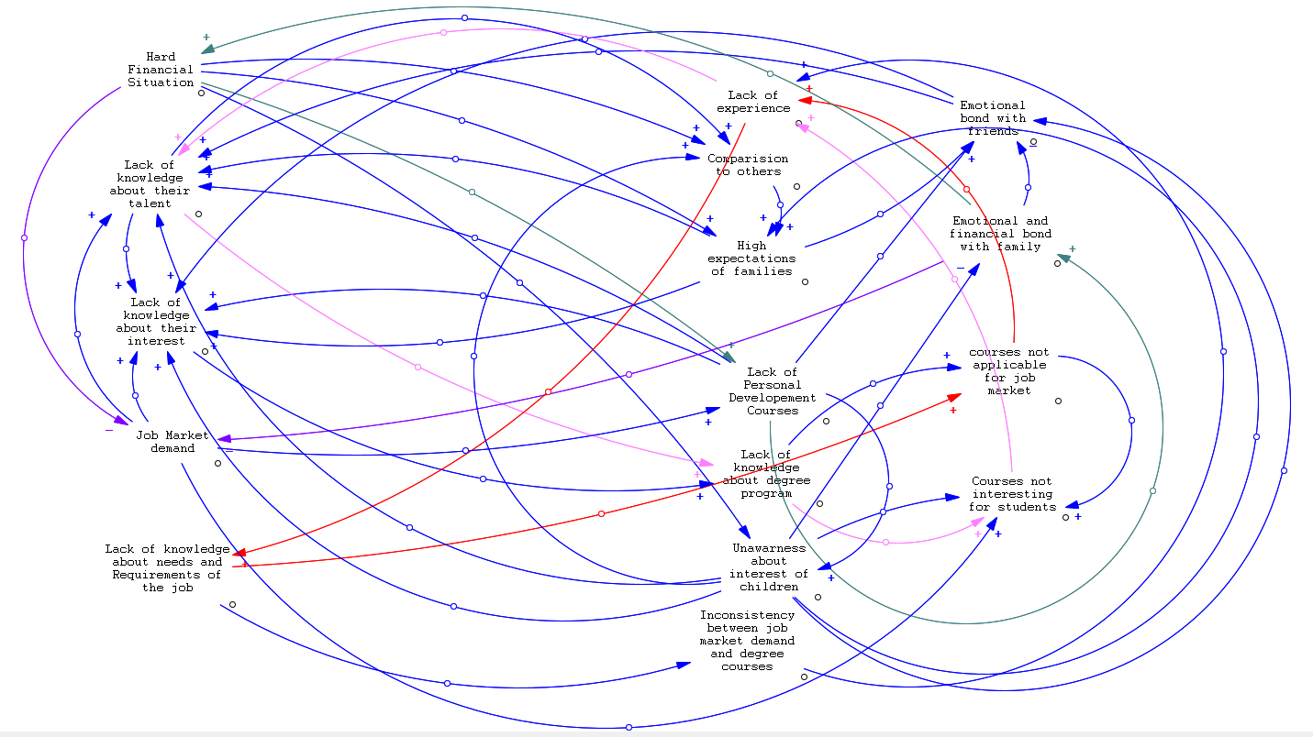
Causal Loop Diagram

Slide 6
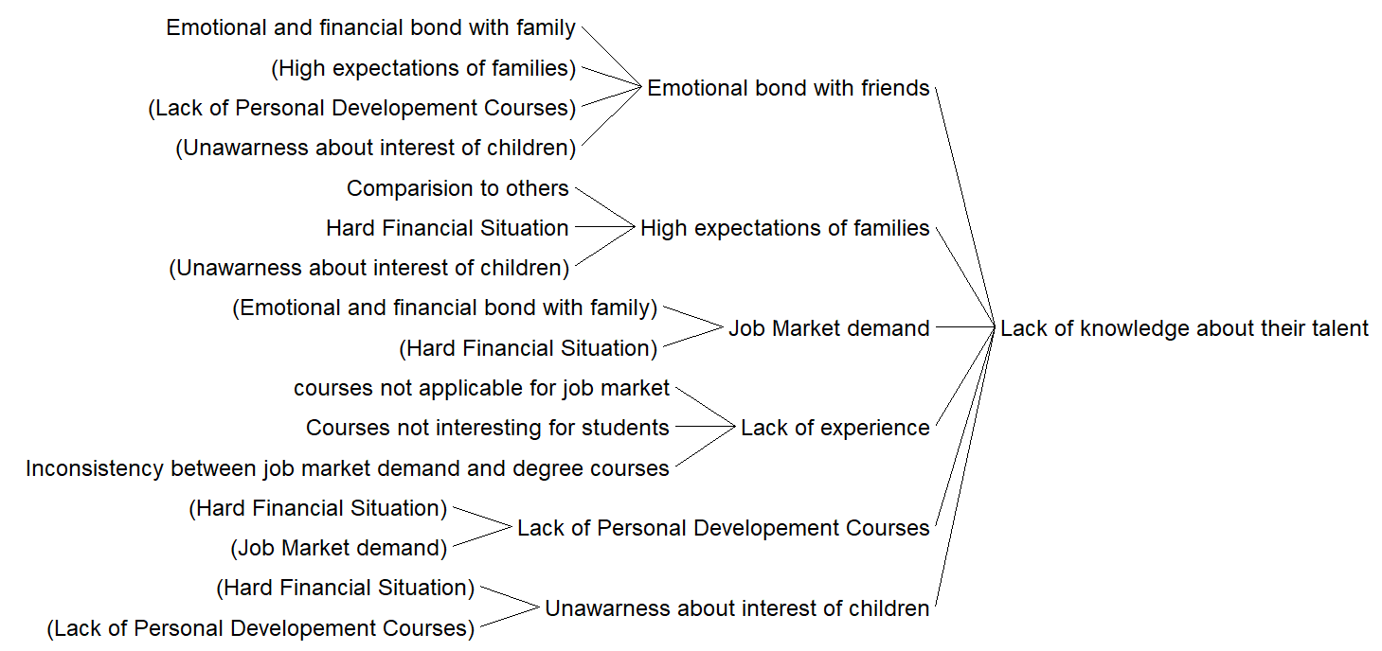
Most influenced items

Slide 7
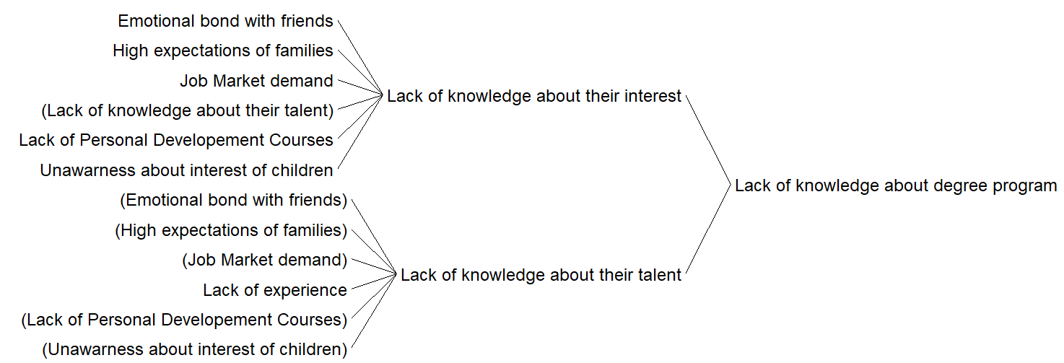
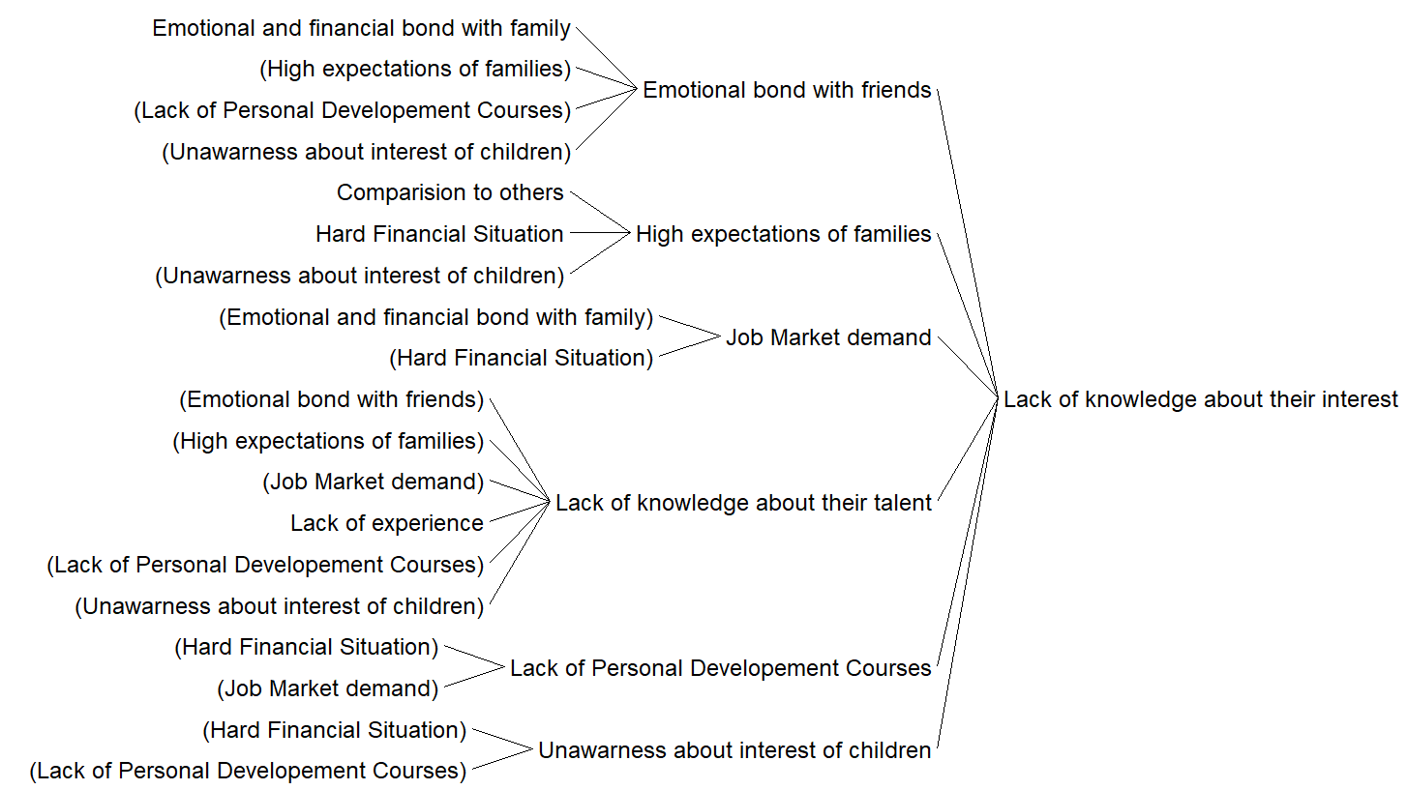
Most influenced items

Slide 8
Viable Scenarios
Scenario 1: Partner with educational institutions and offer CareerQuest VR as a supplementary tool to support their curriculum. This scenario would involve working with schools and universities to integrate the CareerQuest VR platform into their existing curriculum, allowing students to access the virtual learning environment alongside their regular coursework. This scenario would help students to improve their awareness about their interests and talents and helps them in choosing their ideal job. This scenario would require collaboration with educational institutions, companies and potentially long-term contracts.
Scenario 2: Offer CareerQuest VR as a standalone training program to individuals seeking career development opportunities. This scenario would involve marketing the CareerQuest VR platform to individuals interested in pursuing careers in specific industries, such as healthcare, technology, or engineering. It can also be offered to companies to be used before the process of hiring new employees. Users would be able to access the platform on their own time and complete modules related to their chosen field or based on the companies demand. This scenario helps employees to improve their awarness about the job’s needs and Requirements and based on these and their interest choose their career path. This scenario requires marketing efforts, collaboration with companies and educational institutions.

Slide 9


Used Software
Visual Paradigm Online
Vensim PLE

